Slide 1
Designing, coding and testing windows forms application
Chapter - 4

Slide 2
How to design a form
When you create a new project, the project begins with a single, blank form.
You can then add controls to this form and set the properties of the form and controls so they look and work the way you want.

Slide 4
The design of the Invoice Total form
A text box is used to get the subtotal from the user. Read-only text boxes are used to display the discount percent, discount amount, and total.
And label controls are used to identify the values that are in the text boxes on the form.
After entering a subtotal, the user can click the Calculate button to calculate the discount percent, discount amount, and total.
Alternatively, the user can press the Enter key to perform the calculation.

Slide 5
The design of the Invoice Total form
To calculate another invoice total, the user can enter another subtotal and then click the Calculate button or press the Enter key again.
To close the form and end the application, the user can click the Close button in the upper right corner of the form or click the Exit button.
Alternatively, the user can press the Esc key to exit from the form.
The user can press Alt+C to access the Calculate button or Alt+X to access the Exit button. On most systems, the letters that provide the access to these buttons aren't underlined until the user presses the Alt key.

Slide 6
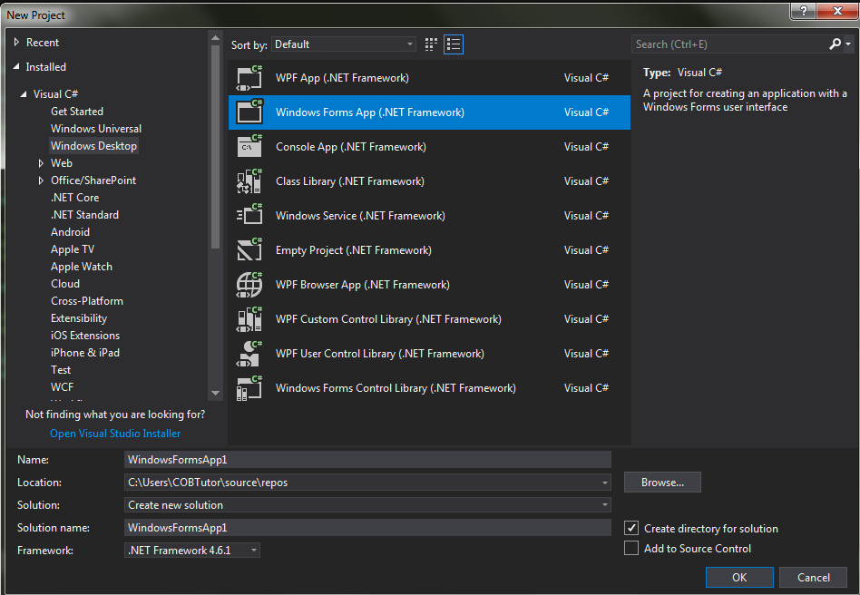
Open a Windows form application
Click File – New - Project

Slide 7
add controls to a form
Three ways to add a control to a form
Select the control in the Toolbox. Then, click in the form where you want to place the control.
Or, drag the pointer on the form to place the control and size it at the same time.
Double-click the control in the Toolbox. Then, the control is placed in the upper left corner of the form. Drag the control from the Toolbox and drop it on the form. Then, the control is placed wherever you drop it.

Slide 8
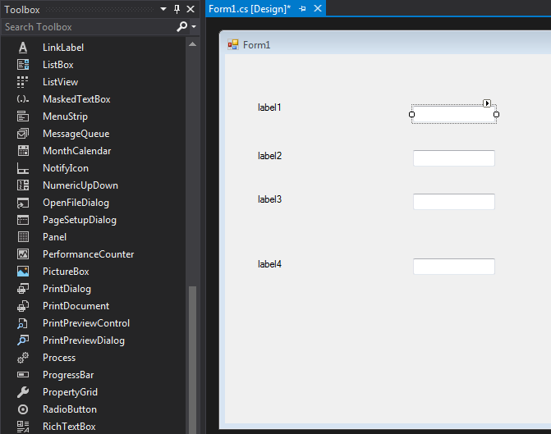
After adding a few controls to the form

Slide 9
How to set properties
The Properties window displays the properties for the object that's currently selected in the Form Designer window.
To display the properties for an object, click on that object or select the object from the drop-down list at the top of the Properties window.
To change a property, enter a value into the text box or select a value from its drop-down list if it has one. If a button with an ellipsis (. .. ) appears at the right side of a property's text box, you can click on the ellipsis to display a dialog box that lets you set options for the property.
To change the properties for two or more controls at the same time, select the controls. Then, the common properties of the controls are displayed in the Properties window.

Slide 10
How to set properties
When you click on a property in the Properties window, a brief explanation of the property appears in a pane at the bottom of the window.
For more information, press F1 to display the help information for the property.
You can use the first two buttons at the top of the Properties window to sort the properties by category or alphabetically.
You can use the plus (+) and minus (-) signs displayed to the left of some of the properties and categories in the Properties window to expand and collapse the list of properties.

Slide 11
Common properties for forms and controls

Slide 12
Common properties for forms and controls

Slide 13
Common properties for forms and controls

Slide 14
Common properties for forms and controls

Slide 15
How to adjust the tab order
Tab order refers to the sequence in which the controls receive the focus when the user presses the Tab key. You should adjust the tab order so the Tab key moves the focus from one control to the next in a logical sequence.
Each control has a Tablndex property that indicates the control's position in the tab order.
You can change this property to change a control's tab order position. If you don't want a control to receive the focus when the user presses the Tab key, change that control's TabStop property to False.
Label controls don't have a TabStop property so they can't receive the focus.

Slide 16
How to set access keys
Access keys are shortcut keys that the user can use in combination with the Alt key to quickly move to individual controls on the form.
You use the Text property to set the access key for a control by placing an ampersand immediately before the letter you want to use for the access key.
For example, &lnvoice sets the access key to I, but I&nvoice sets the access key to n.

Slide 17
How to set access keys
Since the access keys aren't case sensitive, &N and &n set the same access key. When you set access keys, make sure to use a unique letter for each control. If you don't, the user may have to press the access key two or more times to select a control.
You can't set the access key for a text box. However, if you set an access key for a label that immediately precedes the text box in the tab order, the access key will take the user to the text box.

Slide 18
How to set the Enter and Esc keys
The AcceptButton property of the form sets the button that will be activated if the user presses the Enter key.
The CancelButton property of the form sets the button that will be activated if the user presses the Esc key. This property should usually be set to the Exit button.

Slide 22
How to rename a file, project, or solution
You can rename a file, project, or solution by right-clicking on it in the Solution Explorer window and selecting the Rename command from the shortcut menu.
Or, you can select the file, project, or solution in the Solution Explorer and then press F2. Then, you can enter the new name for the file, project, or solution. Be sure not to change or omit the file extension when you rename a file.
Remember too that using a three-letter prefix to indicate the contents of the file (like frm for a form file) makes it easier to tell what each file represents.
When you change the name of a form file, Visual Studio will also change the Name property for the form and update any references within the existing code for the form, which is usually what you want.

Slide 23
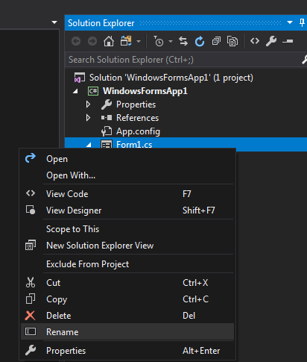

Slide 24
code and test a Windows Forms application

Slide 25
Class and object concepts
An object is a self-contained unit that combines code and data. Two examples of objects you have already worked with are forms and controls.
A class is the code that defines the characteristics of an object. You can think of a class as a template for an object.
An object is an instance of a class, and the process of creating an object from a class is called instantiation.
More than one object instance can be created from a single class. For example, a form can have several button objects, all instantiated from the same Button class. Each is a separate object, but all share the characteristics of the Button class.

Slide 26
Property, method, and event concepts
Properties define the characteristics of an object and the data associated with an object.
Methods are the operations that an object can perform.
Events are signals sent by an object to the application telling it that something has happened that can be responded to.
Properties, methods, and events can be referred to as members of an object.
If you instantiate two or more instances of the same class, all of the objects have the same properties, methods, and events. However, the values assigned to the properties can vary from one instance to another.

Slide 28
How to refer to properties, methods and events

Slide 32
How an application responds to events
Windows Forms applications work by responding to events that occur on objects.
To indicate how an application should respond to an event, you code an event handler, which is a special type of method that handles the event.
To connect the event handler to the event, Visual Studio automatically generates a statement that wires the event to the event handler. This is known as event wiring.
An event can be an action that's initiated by the user like the Click event.

Slide 36
How to create an event handler for the default event of a form or control
The method declaration for the event handler that's generated when you double-click on an object in the Form Designer includes a method name that consists of the object name, an underscore, and the event name.
The event handler is stored in the .cs file for the form. Most of the code that's generated when you design a form, including the statement that wires the event to the event handler, is stored in the Designer.cs file for the form.

Slide 37
How event wiring works
When you use the Form Designer to generate an event handler, a statement is also generated in the Designer.cs file for the form.
If you delete an event handler, for example, you '11 also need to delete any statements that wire events to the event handler. If you don't, you'll get an error when you try to run the application. This error will be displayed in an Error List window, and it will indicate that the event handler is missing.
One way to correct this error is to double-click on the error message in the Error List window. This will open the Designer.cs file for the form and jump to the statement that contains the wiring for the missing event handler. Then, you can delete this statement.

Slide 38
How to handle the Click event of a button
In the Form Designer, double-click the control.
This opens the Code Editor, generates the declaration for the method that handles the event, and places the cursor within this declaration.
Type the C# code between the opening brace { and the closing brace } of the method declaration.
When you are finished writing code, you can return to the Form Designer by clicking on its tab.

Slide 40
How IntelliSense helps you enter the code for a form
The IntelliSense that's provided for C# lists keywords, data types, variables, objects, and classes as you type so you can enter them correctly.
When you highlight an item in a completion list, a tool tip is displayed with information about the item.
If you need to see the code behind a completion list without closing the list, press the Ctrl key. Then, the list is hidden until you release the Ctrl key.

Slide 43
How to detect and correct syntax errors
Visual Studio checks the syntax of your C# code as you enter it. If a syntax error (or build error) is detected, it's highlighted with a wavy underline in the Code Editor, and you can place the mouse pointer over it to display a description of the error.
If the Error List window is open, all of the build errors are listed in that window. Then, you can double-click on any error in the list to take you to its location in the Code Editor.
When you correct the error, it's removed from the error list. If the Error List window isn't open, you can display it by selecting the Error List command from the View menu.
Then, if you want to hide this window, you can click its Auto Hide button. Visual Studio doesn't detect some syntax errors until the project is built. As a result, you may encounter more syntax errors when you build and run the project.

Slide 46
Comment Your Code
You next add a comment to your code. A comment is a note that doesn't change the way the program behaves. It makes it easier for someone who is reading your code to understand what it does.
Adding comments to your code is a good habit to get into. In Visual C#, two forward slashes (//) mark a line as a comment.

Slide 47
How to refactor code
The process of revising and restructuring existing code is known as refactoring.
In the Code Editor, rename refactoring is available when you position the cursor on certain types of code symbols. When the cursor is in this position, you can invoke the Rename command by typing the keyboard shortcut (CTRL + R, and Ctrl+R again), or by selecting the Rename command from a smart tag, shortcut menu, or the Refactor menu.

Slide 48
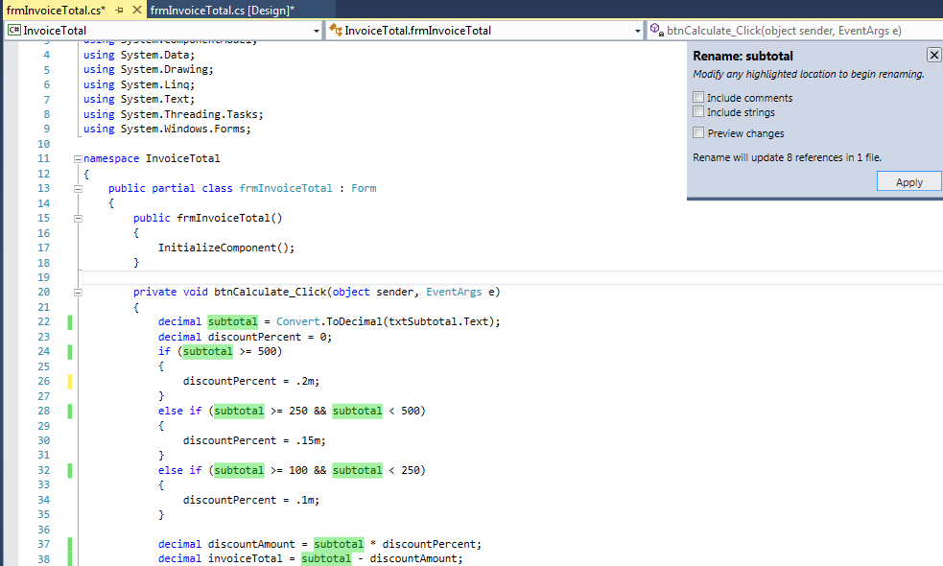

Slide 49
